Slide 1
The if and if-else Statements
Principal forms:

Slide 2
The if and if-else Statements (cont.)
Additional forms:

Slide 3
The if and if-else Statements (cont.)
Better to over-use braces than under-use them
Can help to eliminate logic errors
Condition of an if statement must be a Boolean expression
Evaluates to true or false
A flowchart can be used to illustrate the behavior of if-else statements.

Slide 4
The if and if-else Statements (cont.)
Figure 4-1: Flowcharts for the if and if-else statements

Slide 5
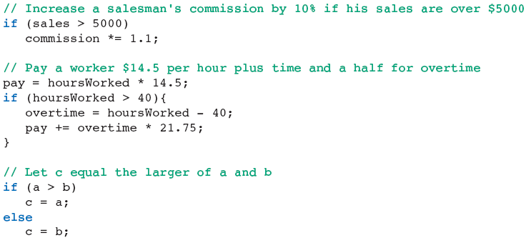
The if and if-else Statements (cont.)
Examples of if statements:

Slide 6
The if and if-else Statements (cont.)
Table 4-3: Relational operators

Slide 7
The while Statement
Provides a looping mechanism
Executes statements repeatedly for as long as some condition remains true

Slide 8
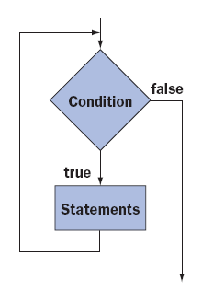
The while Statement (cont.)
Figure 4-2: Flowchart for a while statement

Slide 9
The while Statement (cont.)
Example:
Counter-controlled loop:
cntr is the counter
Loop repeats a determined number of times

Slide 10
The while Statement (cont.)
Tracing: Track value of variables through each iteration of the loop
Table 4-4: Trace of how variables change on each iteration through a loop

Slide 11
The while Statement (cont.)
Counting backward:

Slide 12
The while Statement (cont.)
Task-controlled loop: Continues to execute until some task is accomplished

Slide 13
The while Statement (cont.)
Common structure of a while loop:

Slide 14
The for statement
Combines counter initialization, condition test, and update into a single expression
Easy to create count-controlled loops

Slide 15
The for statement (cont.)
Example:

Slide 16
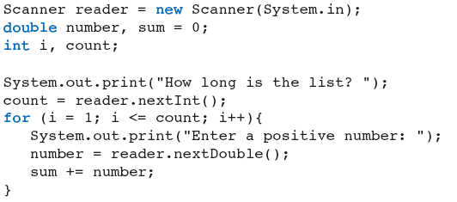
The for statement (cont.)
Count-controlled input:

Slide 17

The for statement (cont.)
Better to declare the loop control variable within the loop header
Only visible within the loop
Variable name can be reused later in other loops

Slide 18
The for statement (cont.)
Both for loops and while loops are entry-controlled loops.
Condition tested at top of loop on each pass
Choosing a for loop versus a while loop is often a matter of style.
for loop advantages:
Can declare loop control variable in header
Initialization, condition, and update in one line of code

Slide 19
Nested Control Statements and the break Statement
Control statements may be nested.

